Slide 1


Slide 2
Mid-Semester Survey
26 Responses till Monday!
Questions in mid-term exam:
One for “Introduction”
One for “Data Processing” and Measures
Just like one of the questions in HW1 but definitely different!
One for “Data Cube”
Just like one of the questions in HW2 but definitely different!
One for “Frequent Pattern Mining”
Just like one of the questions in HW3 but definitely different!
One for “Sequential Patterns”

Slide 3
ResponseBotDemo
As a bot to mine knowledge from response data
As a very simple demo to show how some SciBot’s functions can be developed
http://www.meng-jiang.com/teaching/ResponseBotDemo.zip
How to improve?

Slide 4
ResponseBotDemo
As a bot to mine knowledge from response data
As a very simple demo to show how some SciBot’s functions can be developed
http://www.meng-jiang.com/teaching/ResponseBotDemo.zip
How to improve?
Dimensions? Part-of-speech tags (noun, adj, verb…) as dimensions?
More functions:
Data cube: Return iceberg cells and responses in the cells
Word/bigram clustering: “homework”, “assignments”; “slides”, “materials”
Classification: Predict positive/negative evaluation using words/bigram features
The best way to improve: Collect more data!

Slide 5
How to Understand Small Data Correctly?
Manually.
I will give my response after some following announcement.

Slide 6
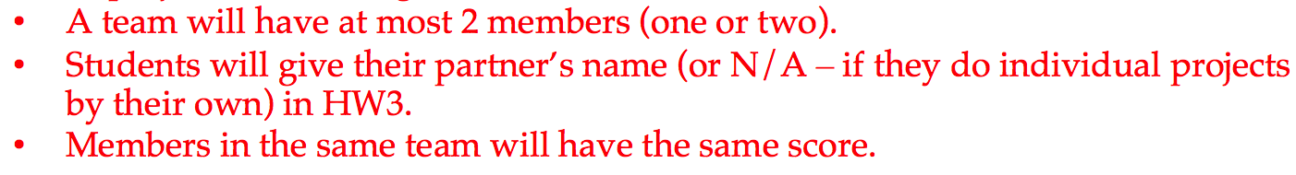
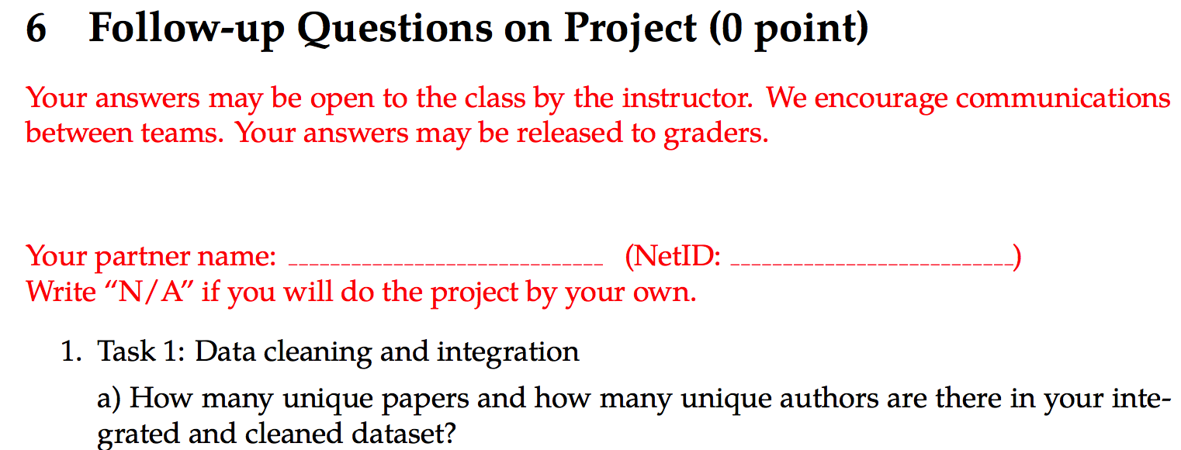
Significant Changes
Individual Team project! (Respect Notre Dame’s teamwork tradition: Go Irish!)
Project instruction [updated]:
HW3 [updated]:

Slide 7
Significant Changes (cont.)
Comparative grading by your hand!
Define “satisfactory”
Completeness: problem description, method, results, evaluation (maybe go back to improve the method)
Make your bot really strong!
 | Student A | Grading A | Student B | Grading B
Task 1-5 | Satisfactory | 5 As | Satisfactory | 5 As
Task 6 | Satisfactory | A | Unsatisfactory | B
Task 7 | Satisfactory | A | Unsatisfactory | B
Task 10 | - |  | Satisfactory | A
Task 11 | - |  | - | -
Overall |  | Full points |  | Full points

Slide 8
PRINCIPLE
Enable more interesting, powerful
features for your SciBot!!!
Surprise graders!

Slide 9
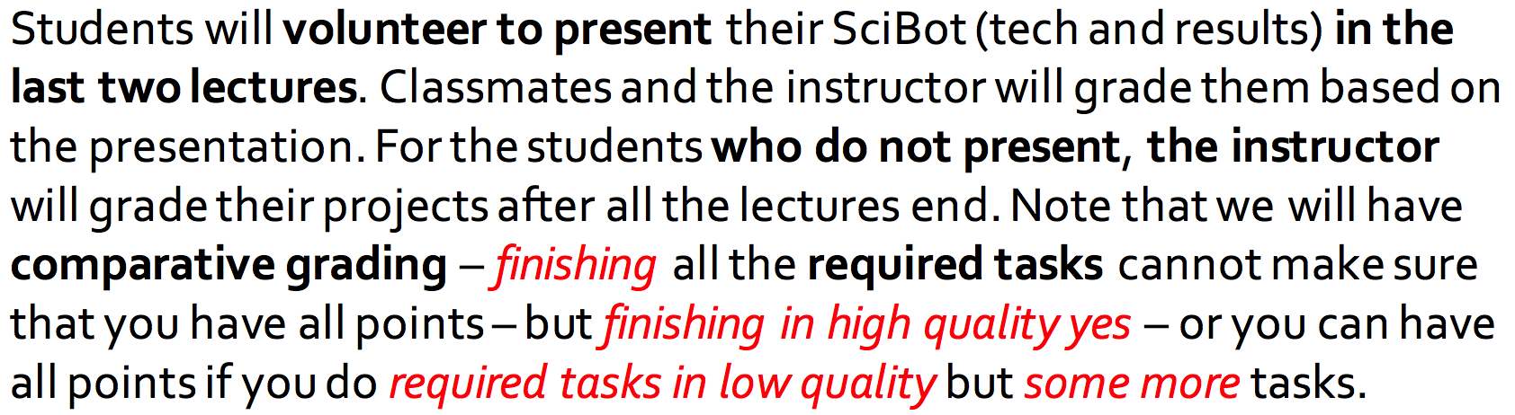
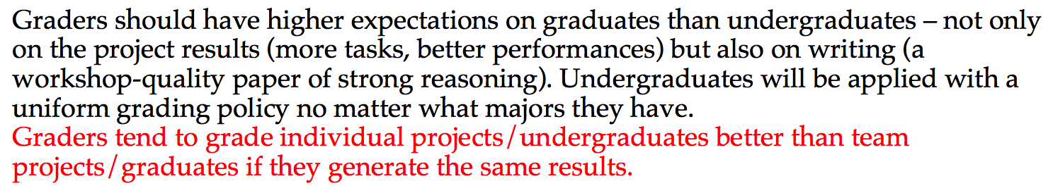
Significant Changes (cont.)

Slide 10
Office Hour
One more before the mid-semester
Oct. 4 Wednesday 10-11 a.m.
326C Cushing Hall
Honestly, there was only one student coming to my office hour before this week. He missed the lecture of project introduction.

Slide 11
My Response to Mid-Semester Survey
Concrete examples for algorithms
Do more example questions in class to better prepare us for the homework assignments, exams, and final project.
See some more programming examples so we know how to actually implement these techniques.
The handouts would have 1-2 example problems that we work through together as a class.
Prepare some in-class exercises that we could do on our own.
MJ: Yes! I will add more real-world examples like the ResponseBot.
MJ: We have toy examples in lectures. They are easy for us to understand algorithm’s details. Think how big a FP-Tree the ResponseBot/SciBot generates.
MJ: We will have handouts/in-class exercises (not for grading) and Jupyter notebook from next chapter. Let’s solve classification problems together.
Does it count?

Slide 12
My Response to Mid-Semester Survey
Content overwhelming
MJ: Before the mid-semester (and before we fully started the project), we learnt Data Processing, Data Cube and Frequent Pattern Mining. After that, we will have only two chapters: Classification and Clustering. Likely you will feel comfortable after the mid-semester.
Cluttered slides
Teaching myself a majority of the material outside of class while I do the homework.
I find myself not learning in class. I usually have to teach myself the material. Class is not valuable.
There aren't that many concrete examples with the math done in class and in the book.
MJ: Thank you! I will for sure improve the slides. Welcome to office hours!
Notes on board are hard to read.
MJ: Thanks! I will improve necessary board writing. We will have notes in slides.

Slide 13
My Response to Mid-Semester Survey
Comparative grading; More room for creativity
There are seniors and grad students in this class where priorities are vastly different, not to mention the different coursework loads.
MJ: This is exactly for leading your creativity to full points. If you enable some new but interesting and powerful functions to your SciBot, graders will be super happy.
MJ: In case that you cannot find interesting tasks beyond required ones, I gave quite a few.
The project could be groups of three?
MJ: No. Graders may expect too much on a group of three. If most of the groups were not productive in this semester, I would make it group-of-three next spring.
Is it necessary to work in a team of 2?
MJ: One or two.

Slide 14
My Response to Mid-Semester Survey
Except for the basic 7 tasks, how many other tasks will each student does on average (according to your past experience)? I am afraid I don‘t have enough time to complete too many alternative tasks.
MJ: Usually one. Two at most. Recall this.
 | Student A | Grading A | Student B | Grading B
Task 1-5 | Satisfactory | 5 As | Satisfactory | 5 As
Task 6 | Satisfactory | A | Unsatisfactory | B
Task 7 | Satisfactory | A | Unsatisfactory | B
Task 10 | - |  | Satisfactory | A
Task 11 | - |  | - | -
Overall |  | Full points |  | Full points

Slide 15
My Response to Mid-Semester Survey
Having a partner or a small group would allow us to not only develop our data science skills, but also allow us the opportunity to simulate a real-world team in creating a project.
MJ: Yes!
I don’t like how the project will graded comparatively, I think if someone completes all of the tasks correctly, they should get an A. Also, having a partner or small group would help immensely because we started the project later in the semester.
MJ: Yes! Please allow someone who (1) did all the required tasks + (2) did NOT complete required tasks correctly + (3) did some other interesting tasks correctly, to have an A.

Slide 16
My Response to Mid-Semester Survey
I also do not like that the project cannot be integrated into my own research project, yet (as a grad student) I am supposed to invest more time into the project?
MJ: Sorry! Three options for next Spring but we cannot offer this semester:
Programming assignments (Apriori, FP-Growth, Decision Tree, Naïve Bayes, K-Means Clustering) + Any data-science-related project
A open project that clearly defines problems of Frequent pattern mining, Classification, Clustering and uses the above techniques (need a milestone, and more “comparative” grading)
This SciBot project that definitely uses these techniques
MJ: Let’s vote!

Slide 17
My Response to Mid-Semester Survey
The scope of the project still seems very intimidating.
MJ: I try to position it as easy but impactful. ResponseBot takes only a few lines of code. A simple SciBot takes not too many.
MJ: Transferable to any text data mining: News (Bloomberg), Social Media (Twitter, Facebook), Biomedical Corpus (some Start-ups), Knowledge Graph (Google, Microsoft) …

Slide 18
My Response to Mid-Semester Survey
HW1 and HW2 too long
MJ: Sorry for that. I am shortening homeworks. Hope you can feel the effort.
Slow down definitions and clarity in the examples’ solutions on the slides
MJ: Very good advice. I will!
MJ: Help me! Put up your hand when you don’t understand what I am saying.

Slide 19
My Response to Mid-Semester Survey
Because the first three weeks were taught by a different instructor (I understand this was unpreventable) I feel very lost about the direction of the class and the ultimate goals of the class.
In general I feel very lost in the structure of this class. I think that is because of the changing of instructors a few weeks into the class. The original instructor didn't seem to know what was necessary to cover and the lectures were disjointed and hard to follow. Now that there is a consistent structure, I feel like I am very much behind after a confusing first three weeks.

Slide 20
Data Science Research
Datasets
Data Cleaning
Data Integration
Application Problems
Informal Problem (Task) Definition
Notations
Formal (Learning?) Problem Definition
Task-Relevant Data Selection
Data Mining/Machine Learning
Knowledge (patterns, etc.)
Pattern evaluation
Notes:
Ask good questions. Data engineering and data science.

Slide 21
Concrete Learning Goals
Can process raw data: data cleaning, data integration, data reduction, dimension reduction
Can describe data warehouse, OLAP, data cube concepts and technology that work on multi-dimensional datasets
Can use Apriori and FP-Growth for frequent pattern mining
Can describe diverse patterns, sequential patterns, graph patterns
Can use Decision Tree, Naïve Bayes, Ensembles for classification
Can describe SVMs and Neural Networks for classification
Can use K-Partitioning Methods (K-Means, etc.) for clustering
Can describe Kernel-based Clustering and Density-based Clustering
Can use appropriate measures to evaluate results of different functionalities

Slide 22
My Response to Mid-Semester Survey
I think the class is very interesting and the TA is also very nice. However, there should really be more office hours - the hours picked out for the TA and Prof. Jiang is not sufficient for everyone.
MJ: We will have one more office hour before mid-semester exam. I really really expect you to come.
More Candy and more Alan.
MJ: My pleasure!

Slide 23
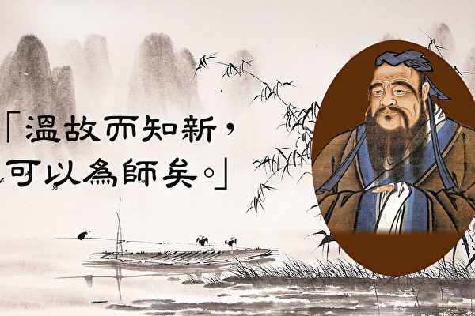
Course Review 1: Chapter 1 to 7
Meng Jiang
Data Science

Slide 24
Chapter 1: Introduction

Slide 25
What is Data Science?
“...the process of automatically discovering useful information in large repositories of data.” — Introduction to Data Mining (Tan, Steinbach, & Kumar)
“...the process of discovering patterns in data.” — Data Mining: Practical Machine Learning Tools and Techniques, 3rd Edition (Witten, Frank, & Hall)
“...the process of discovering interesting patterns and knowledge from large amounts of data.” — Data Mining: Concepts and Techniques, 3rd Edition (Han, Kambler, & Pei)

Slide 26
Our Definition of the Course
“...the art and craft of extracting knowledge from large bodies of structured and unstructured data using methods from many disciplines, including (but not limited to) machine learning, databases, probability and statistics, information theory, and data visualization.”

Slide 27
Data Science Research
Datasets
Data Cleaning
Data Integration
Application Problems
Informal Problem (Task) Definition
Why “SciBot” is data science research?
Task 1: Cleaning and integration
Task 2: Entity name generation (word_word)
Task 3: Entity typing (entity_type)
Task 4: Collaboration discovery (author_author)
Task 5: Problem-method association (problem_method)
Task 6: Method classification (item: method, label: conference)
Task 7: Paper clustering (item: paper, cluster: conference)
Notations
Formal (Learning?) Problem Definition
Task-Relevant Data Selection
Data Mining/Machine Learning
Knowledge (patterns, etc.)
Pattern evaluation
Notes:
Ask good questions. Data engineering and data science.

Slide 28
Chapter 2: Getting to know your data
Description & Visualization

Slide 29
Concepts
Data object and attribute types
Transactions, sequences, graphs/networks …
Nominal, binary, ordinal, numeric
Statistical description of data
Central tendency: Mean, median, mode, max, min …
Outlier-ness: Variance, standard deviation, Z-score …
Data visualization
Boxplot, histogram, bar chart, quantile plot, Q-Q plot, scatter plot; word cloud, network…

Slide 30
Distance and Similarity
Minkowski distance measures
Manhattan, Euclidean, “supremum”
Similarity measures
Jaccard
Cosine
Distribution difference measure
KL-Divergence

Slide 31
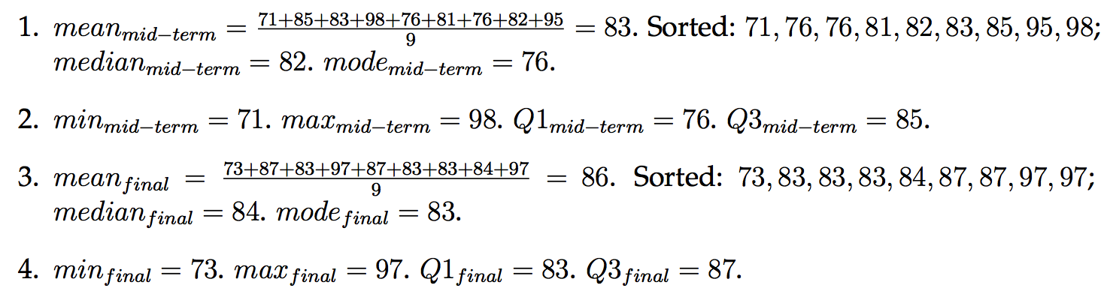
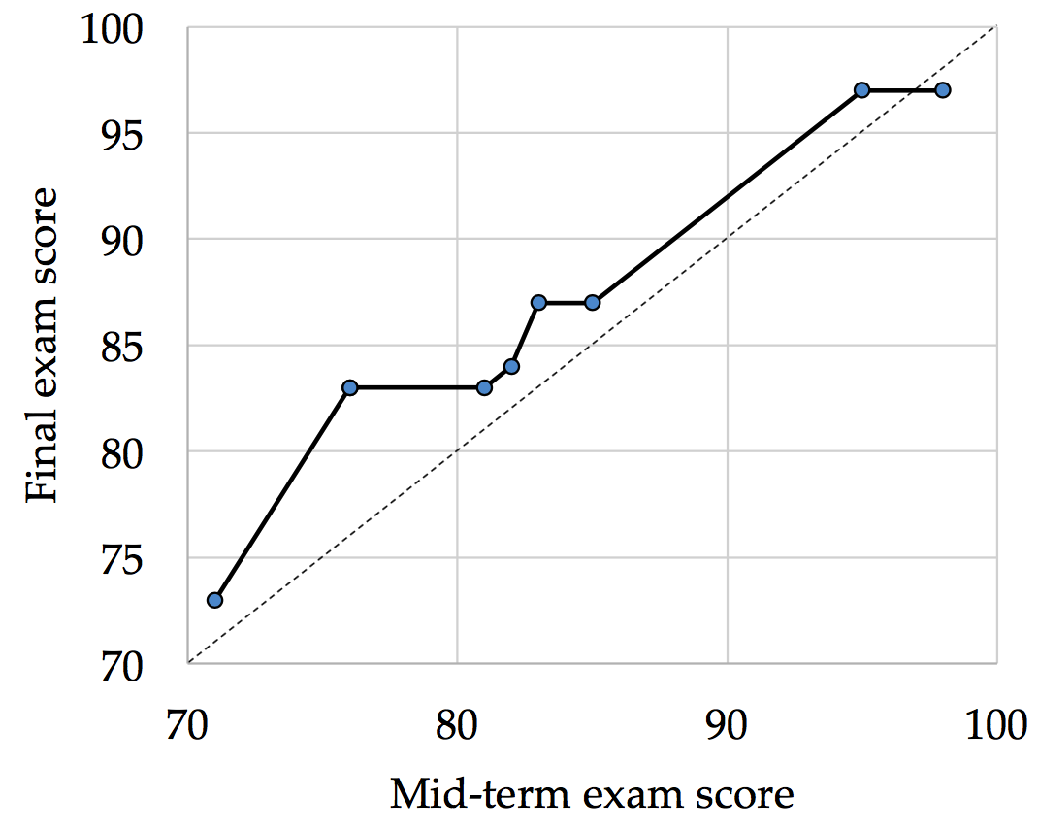
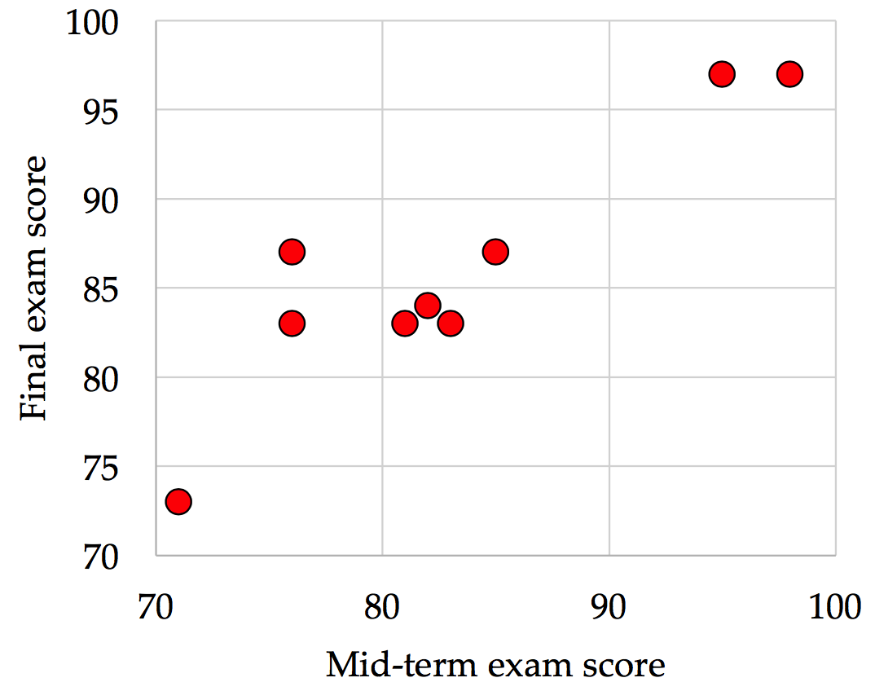
HW1-Q2

Slide 32
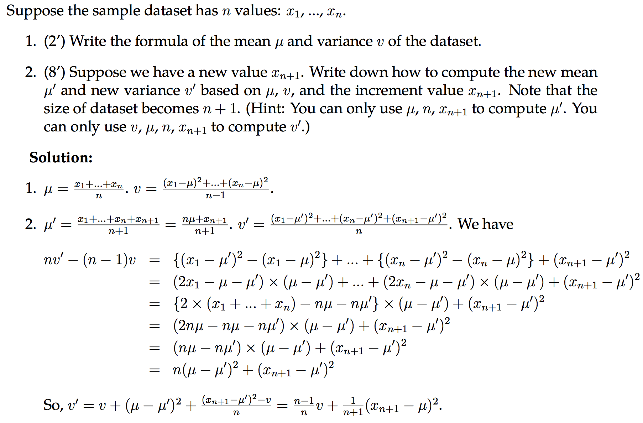
HW1-Q3

Slide 33
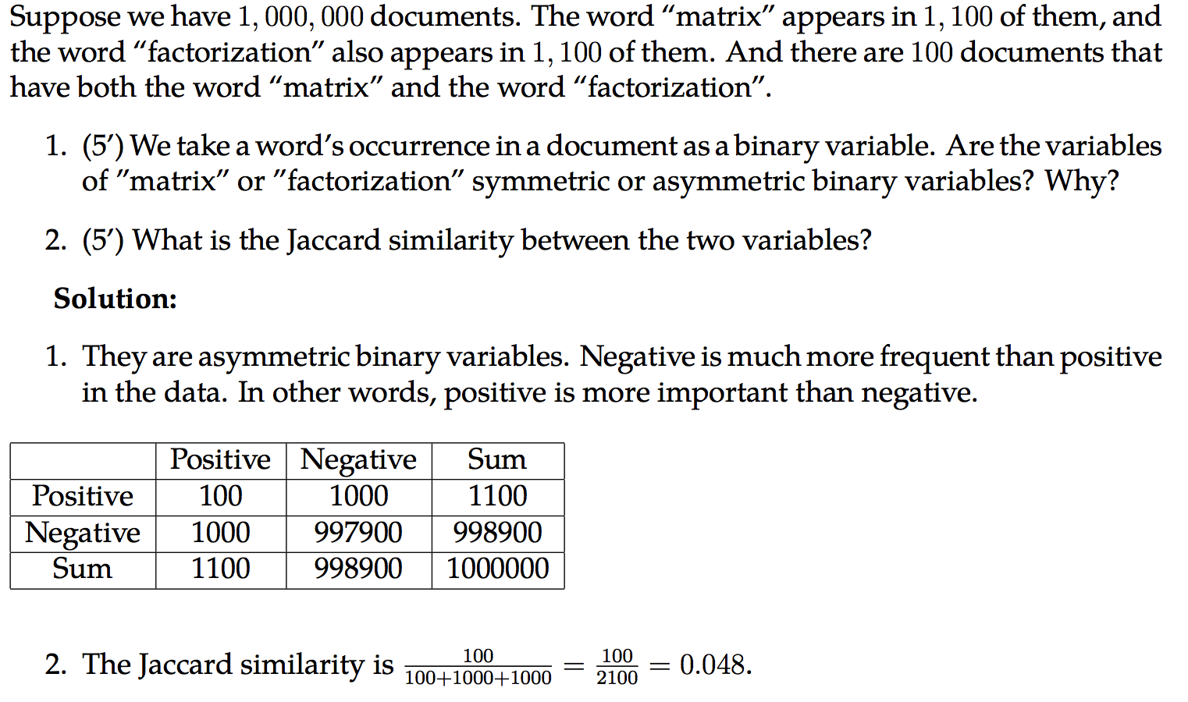
HW1-Q5

Slide 34
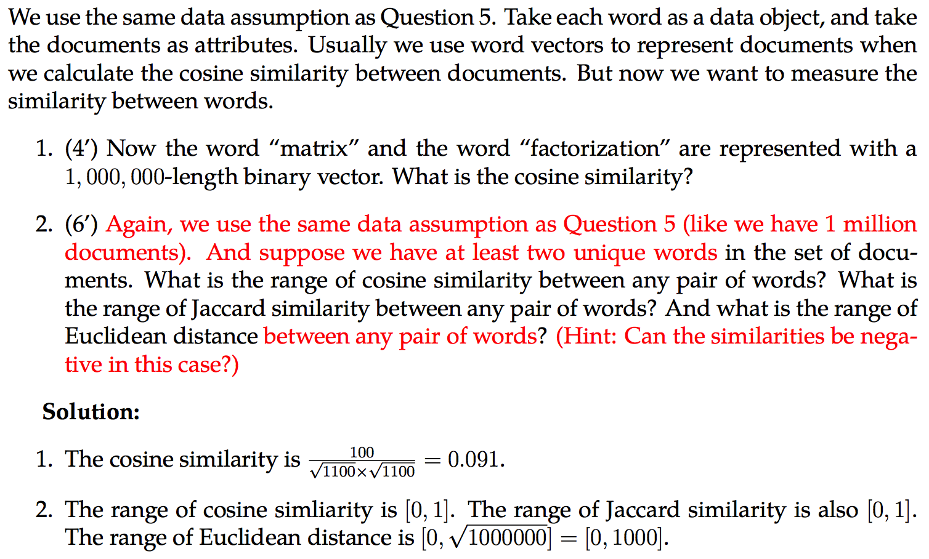
HW1-Q6

Slide 35
Chapter 3: Data Processing
Cleaning, Integration, Reduction

Slide 36
Cleaning and Integration
Incomplete/missing data (Cleaning)
Global constant, attribute mean, most probable value
Noisy data (Cleaning)
Binning, regression, outlier detection, clustering, semi-supervised
Redundancy data (Integration)
Correlation analysis
Categorical attributes → Chi-square test: Null hypothesis, calculation
Numerical attributes → Covariance analysis: Positive, negative, independence, rho, covariance matrix

Slide 37
Reduction
Data reduction
Parametric: Regression, log-liner models
Non-parametric: Histogram, clustering, (stratified) sampling
Min-max/Z-score/Decimal-scaling normalization
Dimension reduction
“Curse of dimensionality”
Feature selection
Attribute subset selection
Feature extraction
Principal Component Analysis (PCA): Eigenvalue, Eigenvectors

Slide 38
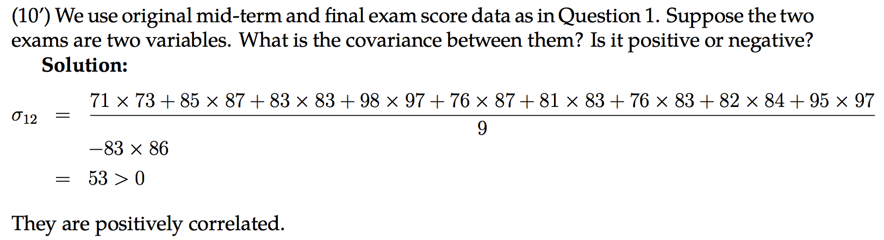
HW1-Q7

Slide 39
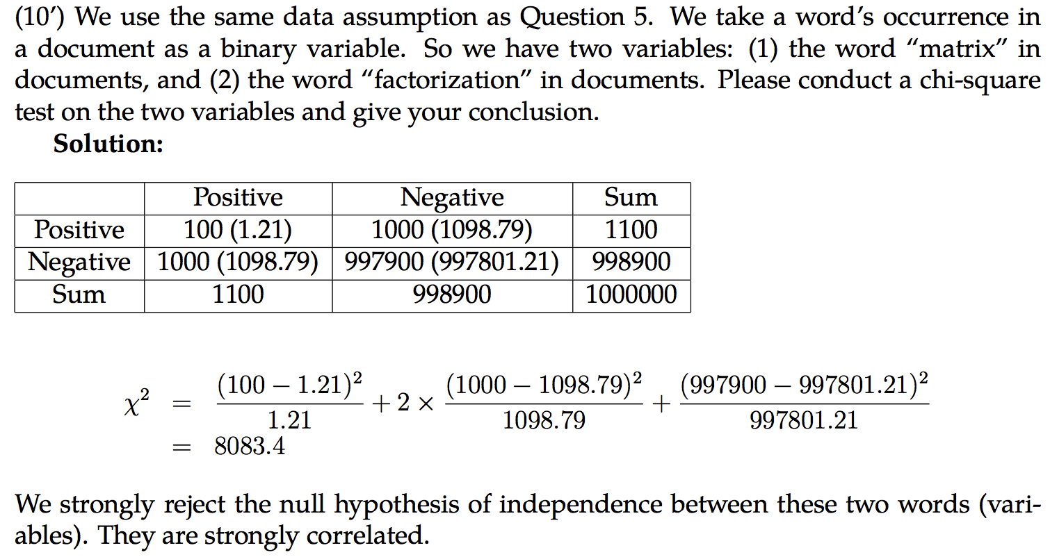
HW1-Q8

Slide 40
Chapter 4: Data Cube
Concepts

Slide 41
Data Cube
Concepts
Cell, Cuboid, Cube
Dimension Value, Dimension Level, Dimension
Components
Dimension tables and Fact tables
Concept hierarchy and Measures
Schemas: What are they?
Operations: What are they?
Materialization: What are they?

Slide 42
Iceberg Cube
Iceberg condition: min_sup (count)
Assumption: “If the base cuboid has only the following base cells:…”
Constraints
Iceberg cells, Non-empty cells, iceberg cube
Base/Aggregate cells/cuboids
Closed cells and closed cube

Slide 43
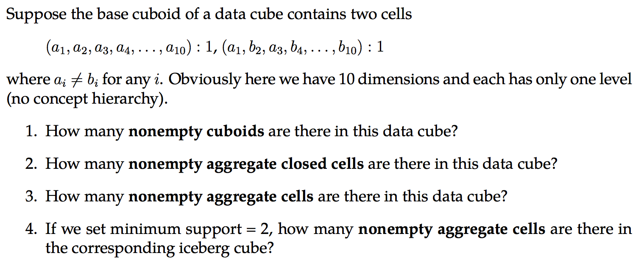
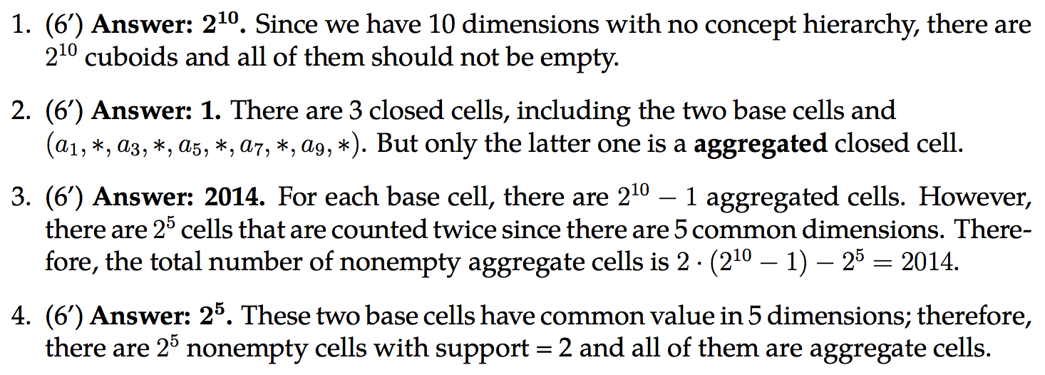
HW2-Q1

Slide 44
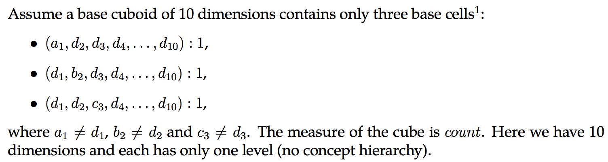
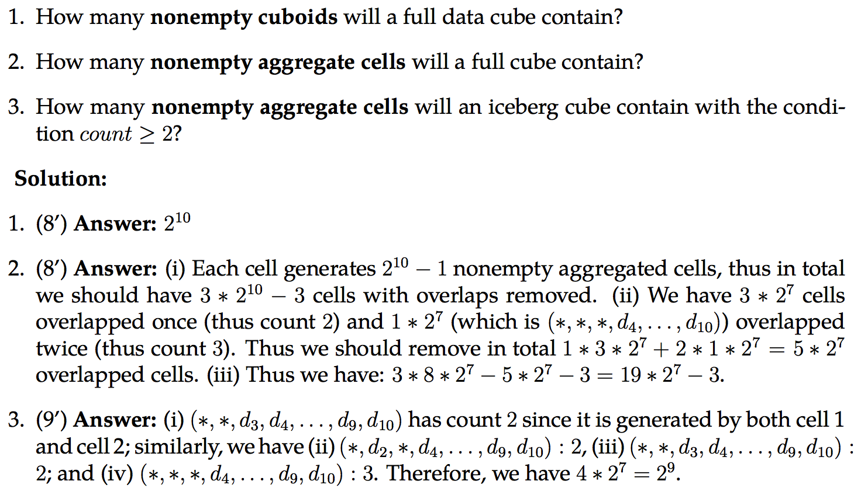
HW2-Q3

Slide 45
Chapter 5: Cube Computation, Data Warehouse and OLAP
Concepts, Algorithms

Slide 46
Cube Computation
Multi-way array aggregation (× Apriori property for iceberg cube; × high dimensionality)
ABC to {AB, AC, BC}: How?
BUC (√ Apriori property for iceberg cube; × high dimensionality)
Shell-fragment (√ For high dimensionality)

Slide 47
Data Warehouse and OLAP
“A data warehouse is a subject-oriented, integrated, time-variant, and nonvolatile collection of data in support of management’s decision-making process.”

Slide 48
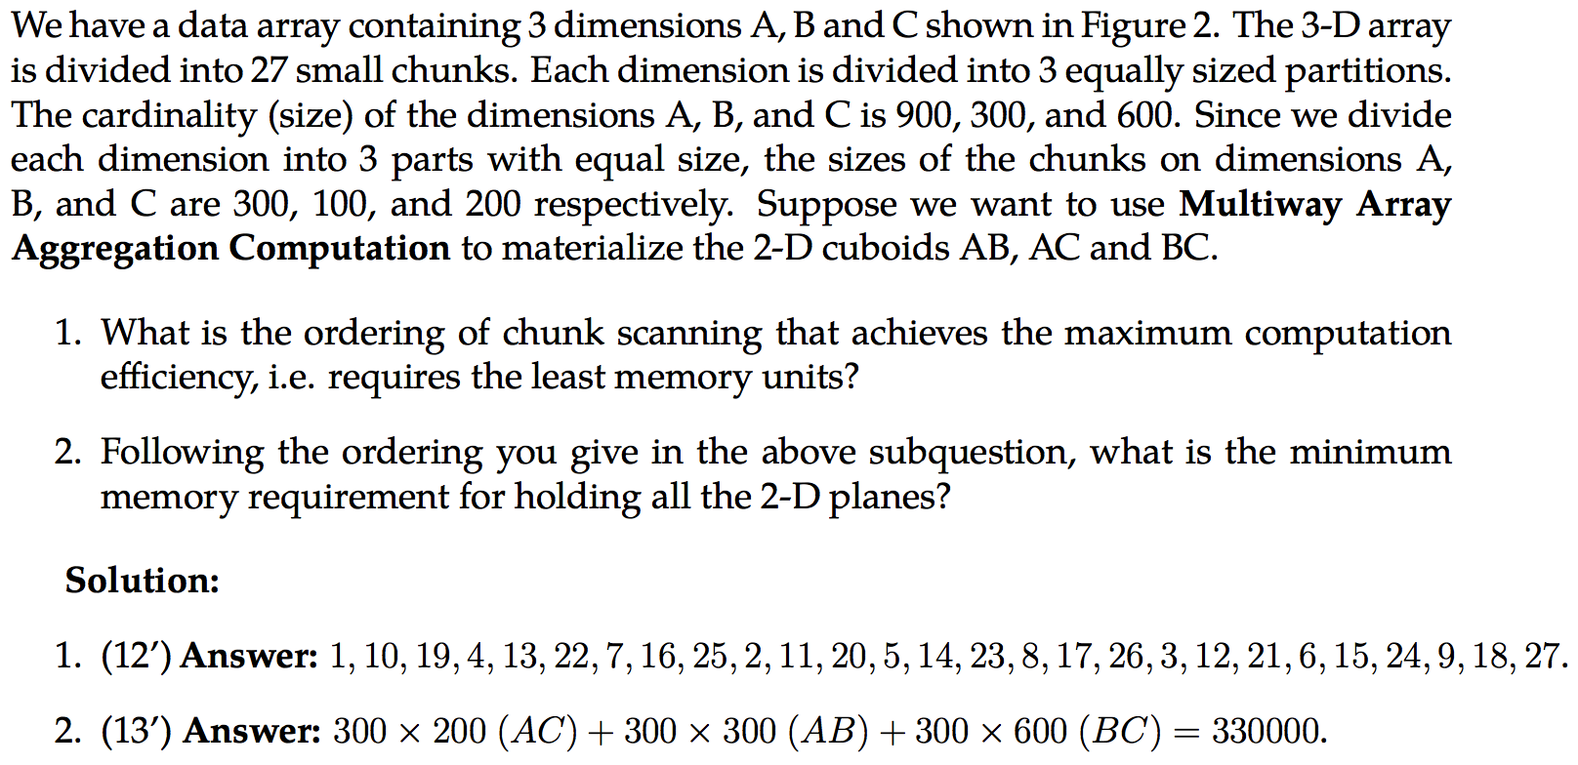
HW2-Q4

Slide 49
Chapter 6: Frequent Pattern Mining
Apriori, FP-Growth and Evaluation

Slide 50
Concepts
Itemset, k-itemset, frequent k-itemset
Absolute/relative support
Association: support and confidence
Closed pattern, Max pattern (lossy)
Apriori property: Any subset of a frequent itemset must be frequent. If any subset of an itemset S is infrequent, then there is no chance for S to be frequent—why do we even have to consider S?!

Slide 51
Apriori
Outline of Apriori (level-wise, candidate generation and test)
Initially, scan DB once to get frequent 1-itemset
Repeat
Generate length-(k+1) candidate itemsets from length-k frequent itemsets
Test the candidates against DB to find frequent (k+1)-itemsets
Set k := k +1
Until no frequent or candidate set can be generated
Return all the frequent itemsets derived

Slide 52
FP-Growth
Idea: Frequent pattern growth (FPGrowth)
Find frequent single items and partition the database based on each such item
Recursively grow frequent patterns by doing the above for each partitioned database (also called conditional database)
To facilitate efficient processing, an efficient data structure, FP-tree, can be constructed
Mining becomes
Recursively construct and mine (conditional) FP-trees
Until the resulting FP-tree is empty, or until it contains only one path—single path will generate all the combinations of its sub-paths, each of which is a frequent pattern

Slide 53
Try WikiBooks’ Example
https://en.wikibooks.org/wiki/Data_Mining_Algorithms_In_R/Frequent_Pattern_Mining/The_FP-Growth_Algorithm

Slide 54
Pattern Evaluation
Interestingness Measures
Subjective
Objective
Support, confidence
Null-variant
Lift: symmetric
Chi-square test
Null-Invariance
AllConf
Jaccard, Cosine
Kulc, MaxConf + Imbalance Ratio

Slide 55
Chapter 7: Advanced Frequent Pattern Mining
Diverse Patterns
Sequential Patterns
Graph Patterns

Slide 56
Concepts
Diverse Patterns
Multiple-Level Associations
Multi-Dimensional Associations
Quantitative Associations
Negative Correlated Patterns
Pattern | Closed Pattern (Concepts) | Idea 1: Pattern candidate generation and pruning | Idea 2: Pattern growth
Frequent pattern (itemset) | Closed frequent itemset | Apriori (1994) | FP-Growth (2000)
Sequential pattern | Closed seq. pattern | GSP (1996) | PrefixSpan (2004)
Graph pattern | Closed graph pattern | FSG (2000-2001) | gSpan (2002)

Slide 57


Mid-term exam:
Oct. 5th (Thursday)
2:00 p.m. – 3:15 p.m. (75 minutes)
In class
Take a pen!!!
You are only allowed to have an A4-size paper double-sided for reference.
I believe you can write a lot a lot on it…
But you don’t have to…

Slide 58
Alan Time
If no one is answering, maybe he/she is behind you ❤

